Slide 1
FINAL PROJECT
SDN
INTELLIGENT TIME VARIANT FIREWALL(ITVF)
Palash Ijari

Slide 2
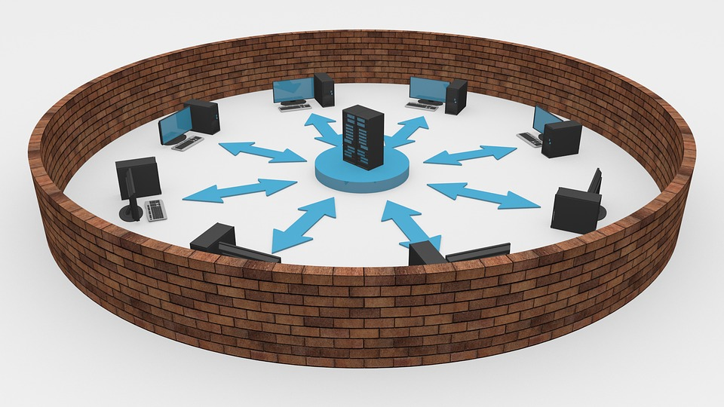
PROBLEM STATEMENT
To create a Firewall which blocks the malicious IP address and reroutes the IP’s which could be a Potential threat in the future.

Slide 3
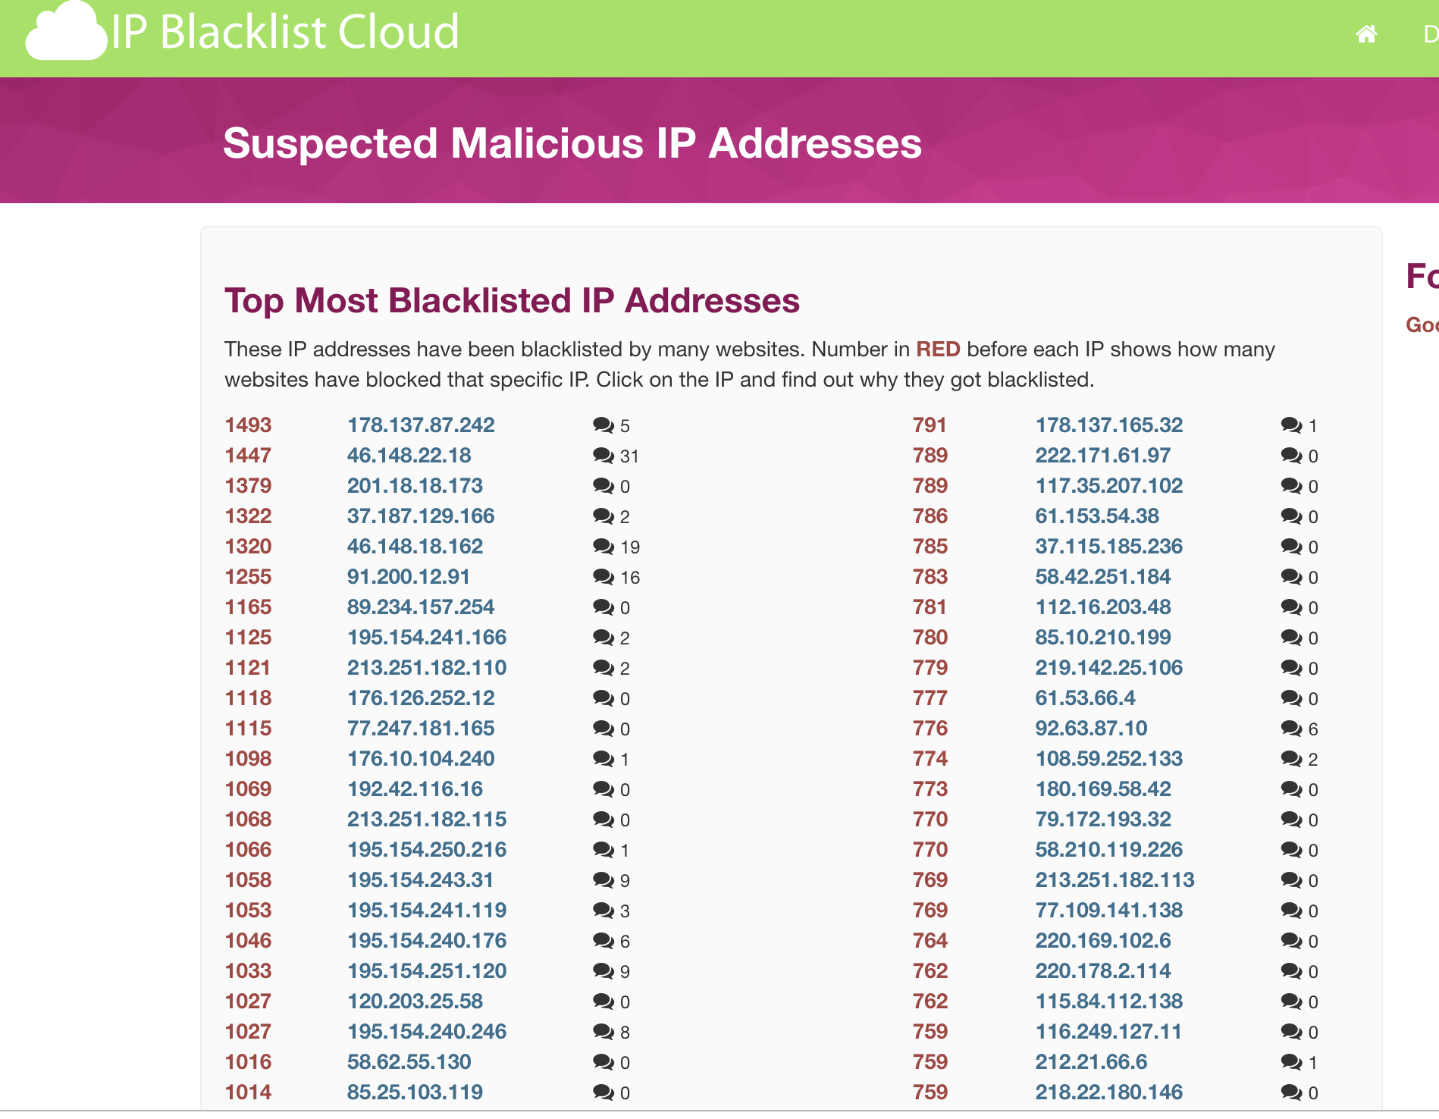
Research on Malicious IP’s and Firewall
The latest research on Malicious IP address says, that the IP’s used by hackers have some similarity between them.
The data has been provided by many datastores such as https://www.ip-finder.me/ip-full-list/
About the malicious IP’s blocked by all the websites around the world.
We can use this trend in the data to block the IP’s which can be a potential threat in the Future using Machine learning.

Slide 4
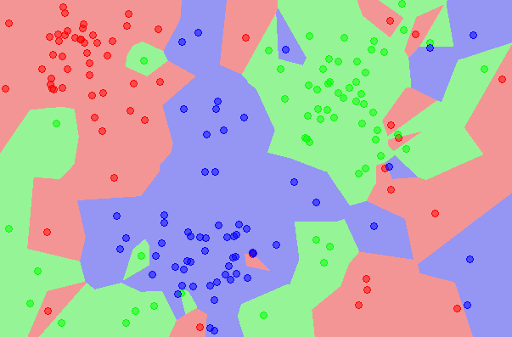
Machine learning
K-Nearest Neighbour
A supervised-classification Algorithm which works on the nearest neighbour policy and labels the data based on the nearest neighbours of the data
The data used here is IP address and they have been converted into a 32 bit unique integer using the “IPaddress” module in python.

Slide 5
PROPOSED SOLUTION
INTELLIGENT TIME VARIANT FIREWALL(ITVF)
A temporal based SDN solution which works on Nearest-Neighbour to detect the malicious IP addresses ,route them through different paths and block them when threat is confirmed.

Slide 6
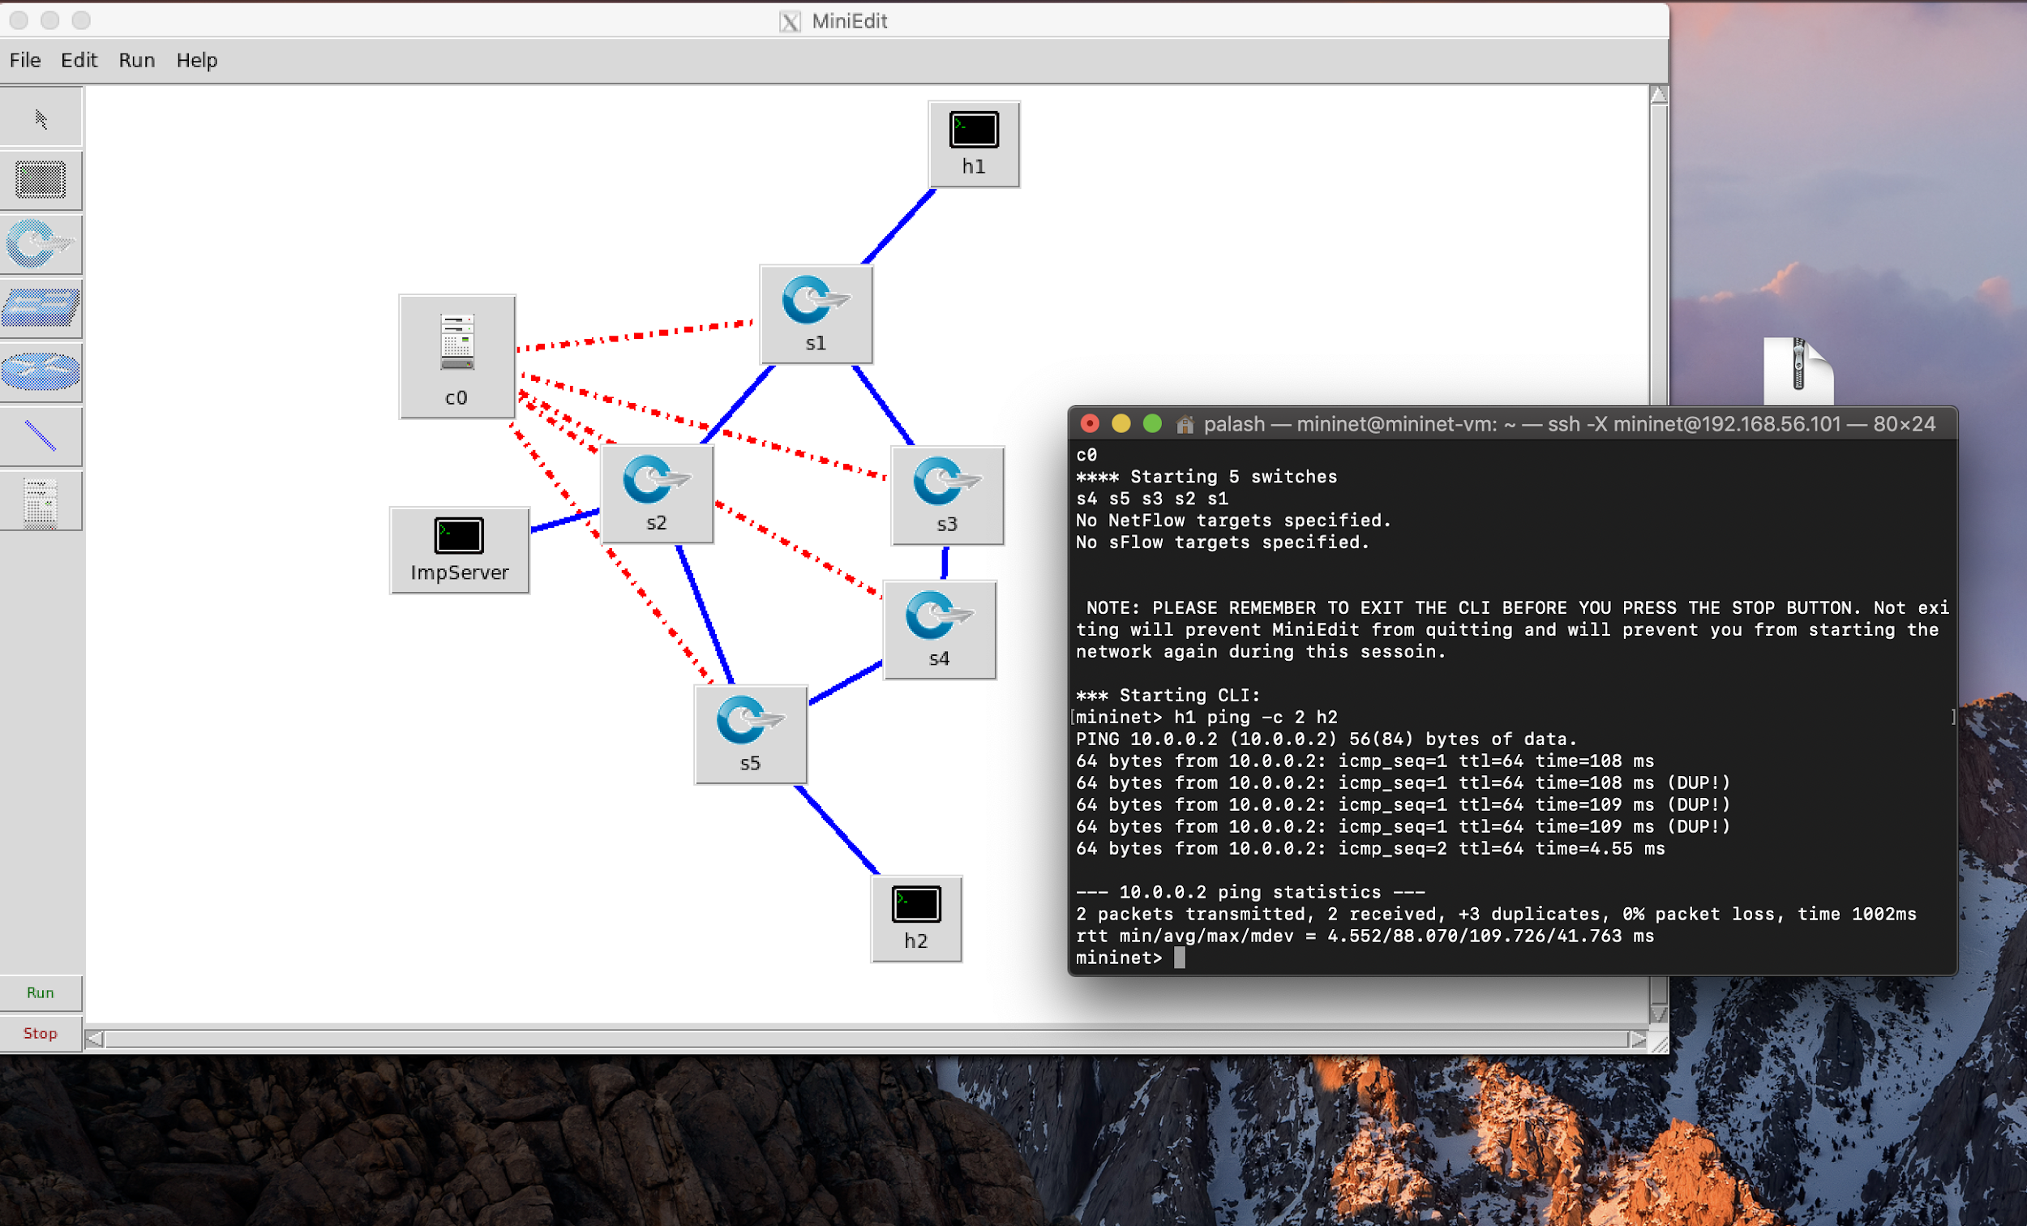
Topology Used
Secured SERVER AREA
Here we could see that there are two paths to H2 where multipath-routing has been enabled but one part is more vulnerable to attacks than the other.

Slide 7
Explanation
Analyze
Machine learning
Controller
Malicious database
SEND IP for CHECKING
RYU-
CONTROLLER
Decision
DUMP FLOWs
Check flows
SDN FRAMEWORK

Slide 8
WORKING
SETUP MININET TOPOLOGY & CHECK FOR CONNECTIVITY

Slide 9
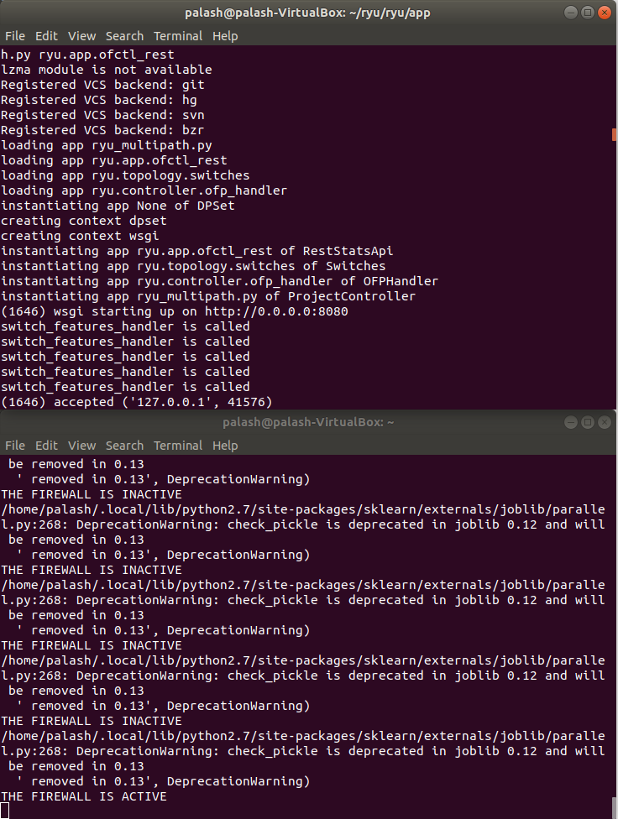
RYU CONTROLLER
Run the RYU CONTROLLER and wait for the multipath to converge

Slide 10
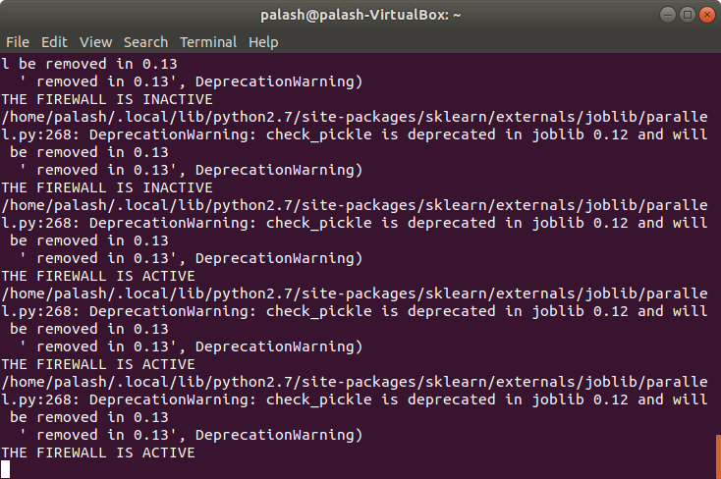
RUN THE ITVF

Slide 11
The FIREWALL Automatically turns UP and goes DOWN with respect to TIME

Slide 12
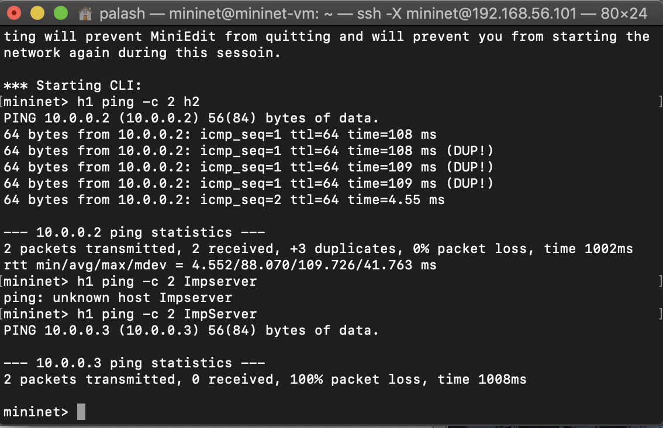
INACTIVE/ACTIVE FIREWALL

Slide 13
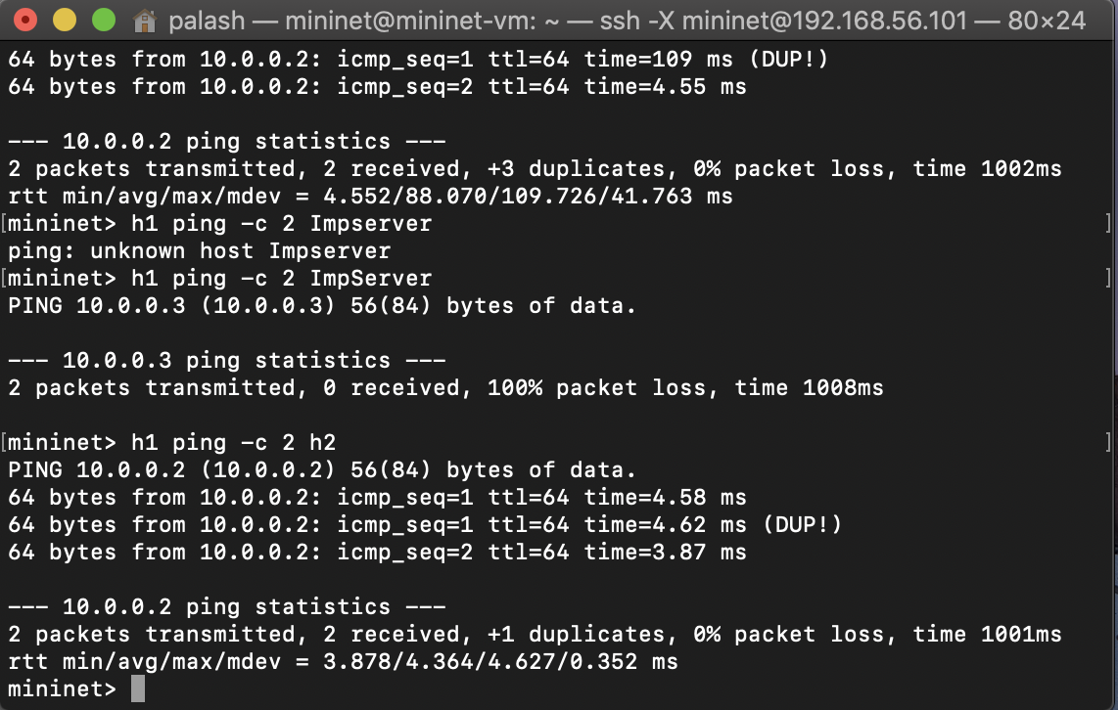
ACTIVE FIREWALL
The path from the secure area is blocked while the packets are routed through other path

Slide 14
$$$ APPLICATIONS $$$
This System can also be used to Change the forwarding actions accordingly to with the TIME.
Imagine h1 is a company which wants to connect to h2 and ImpServer is also a company which dosen’t use it’s bandwidth at certain time of the day, During this time of the day we could automatically setup a path for H1 and H2 and also check for malicious IP’s as earlier. The middle boxes could be added and company’s H1 and H2 could be charged on their USAGE.

Slide 15
THANK-YOU
DEMO

Slide 16
DEPENDENCIES TO DOWNLOAD
IN RYU
$ pip install ryurest
$ git clone https://github.com/nathancatania/ryurest
For More Information please follow the link
https://pypi.org/project/ryurest/
Also place the file ryu_multipath.py in the folder ryu/ryu/app

Slide 17
RUNNING INSTRUCTIONS
IN RYU:
Please Place the files provided 1)TESTRYU.py 2)KNN.py 3)Malware.txt
In one directory
And As explained before please place the ryu_multipath.py in ryu/ryu/app
In first terminal run this Command to start the controller(cd to ryu/ryu/app):
ryu-manager --observe-links ryu_multipath.py ryu.app.ofctl_rest
In the Second Terminal RUN the TESTRYU.py

Slide 18
Mininet/Miniedit
Open the Topology Include the mininet Files in mininet and open it in Miniedit.py and run it.
FILE Enclosures:
1The TESTRYU.py contains the files to push and delete the flows according to teh time(Please Install all the libraries included at the starting of the program)
2)The KNN.py contains the program running Nearest-Neighbour Algorithm also contains a list of all the Malicious IP’s.
3)The Malware.txt contains needs to contains only 1 IP address which needs to be checked by the system for Malware detection.

Slide 19
References
https://pypi.org/project/ryurest/
https://inside-openflow.com/2016/06/23/interactive-ryu-with-postman/
https://github.com/nathancatania/ryurest/blob/master/demos/functional_demo.py
https://www.opennetworking.org/wp-content/uploads/2014/10/openflow-spec-v1.3.3.pdf
https://www.brianlinkletter.com/how-to-use-miniedit-mininets-graphical-user-interface/

Slide 20
References continued...
https://stackoverflow.com/questions/45185910/adding-an-ip-based-flow-entry-using-ryu-rest-api
https://ryu.readthedocs.io/en/latest/ryu_app_api.html
https://wildanmsyah.wordpress.com/2018/01/13/multipath-routing-with-load-balancing-using-ryu-openflow-controller/
http://openstate-sdn.org/
Interesting Concept:http://www.cs.ucc.ie/~ak18/MiniNAM/examples
https://ryu-docs.readthedocs.io/en/stable/gui.html
https://media.readthedocs.org/pdf/ryu/latest/ryu.pdf

